Slide 1
Counting Rules
Dr. John S. Butler

Slide 2
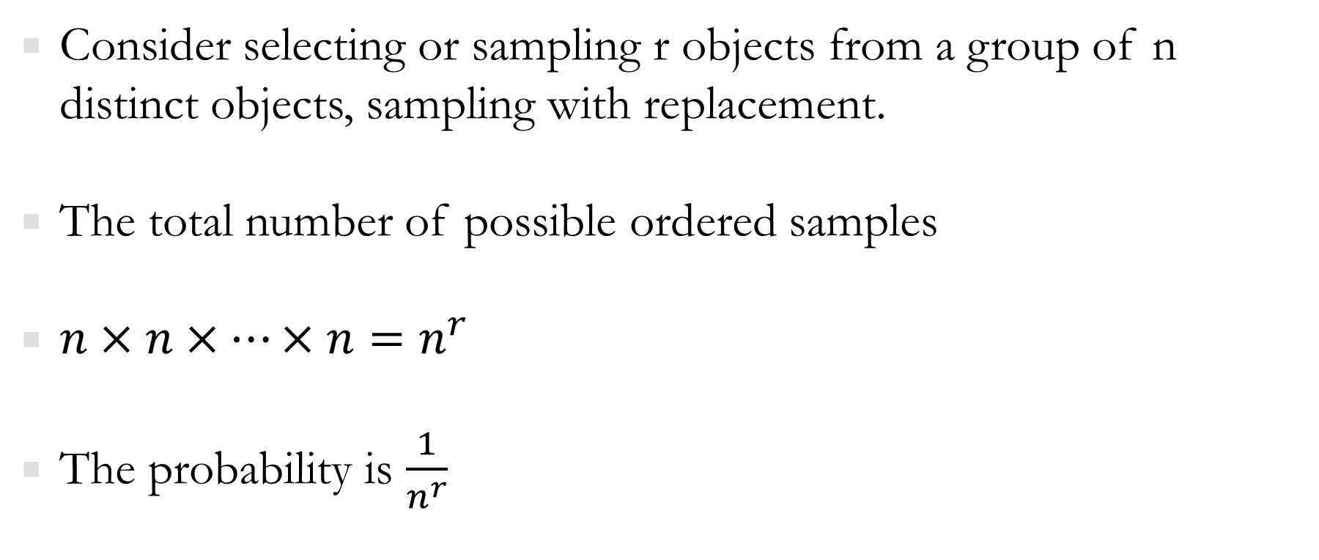
Useful counting Rules
Consider selecting or sampling r objects from a group of n distinct objects, sampling with replacement.
The total number of possible ordered samples
$n×n×…×n=n^{r}$
The probability is $\frac{1}{n^{r}}$

Slide 3
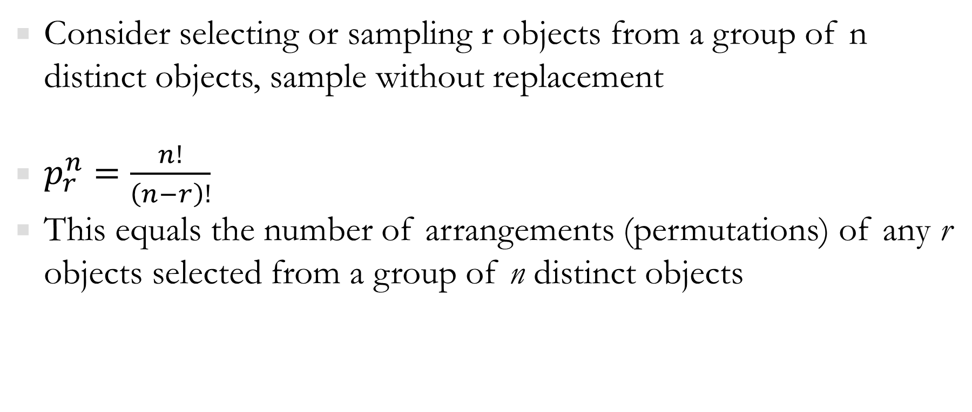
Useful counting Rules
Consider selecting or sampling r objects from a group of n distinct objects, sample without replacement
$p_{r}^{n}=\frac{n!}{\left(n−r\right)!}$
This equals the number of arrangements (permutations) of any r objects selected from a group of n distinct objects

Slide 4
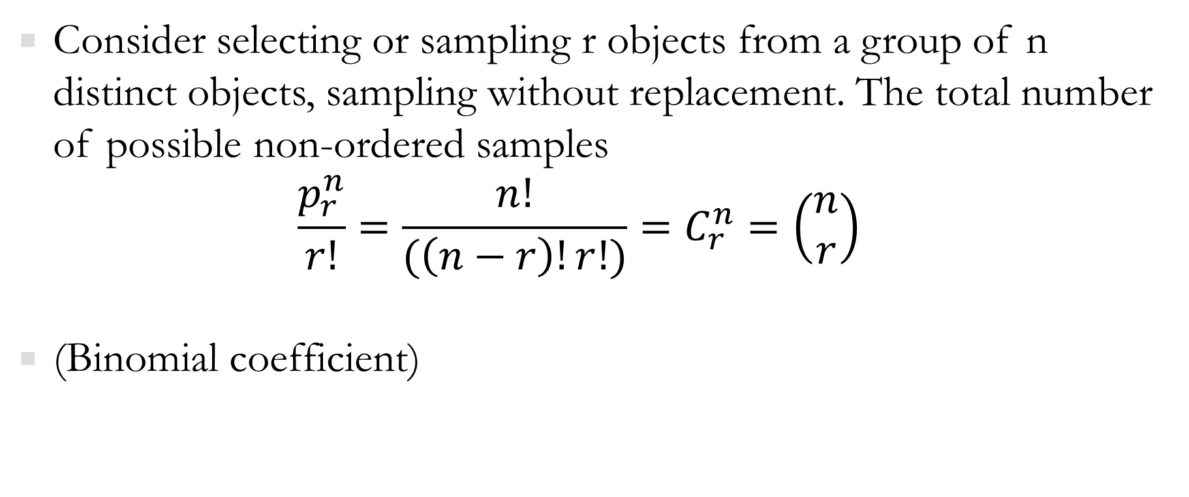
Useful counting Rules
Consider selecting or sampling r objects from a group of n distinct objects, sampling without replacement. The total number of possible non-ordered samples
$$\frac{p_{r}^{n}}{r!}=\frac{n!}{(\left(n−r\right)!r!)}=C_{r}^{n}=\left(\begin{matrix}n \\ r\end{matrix}\right)$$
(Binomial coefficient)

Slide 5
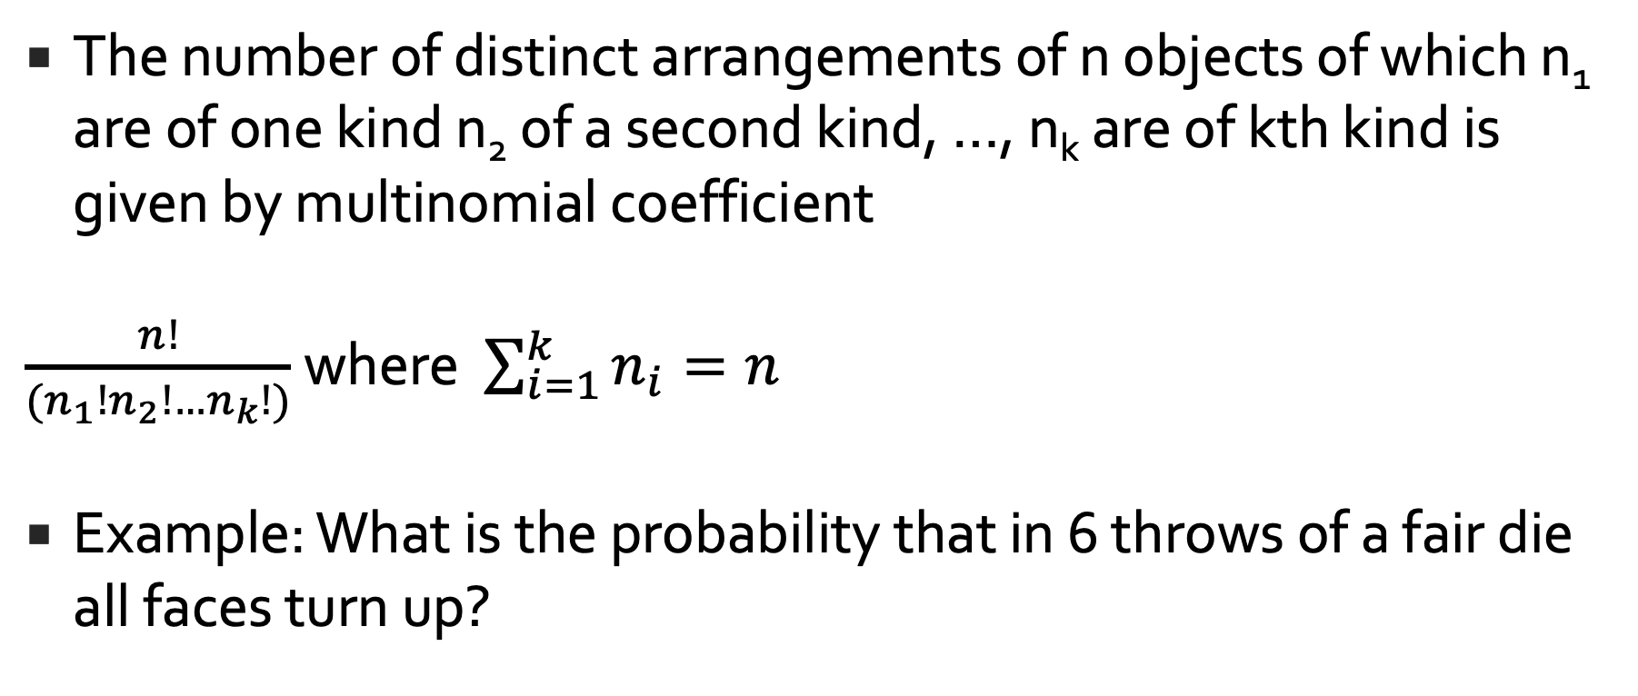
Useful counting Rules
The number of distinct arrangements of n objects of which n₁ are of one kind n₂ of a second kind, …, n_{k} are of kth kind is given by multinomial coefficient
$\frac{n!}{(n_{1}!n_{2}!…n_{k}!)}$ where $\sum_{i=1}^{k}{n_{i}=n}$
Example: What is the probability that in 6 throws of a fair die all faces turn up?

Slide 6
Example
A bank issues bank cards with PINs consisting of 4 digits, each one {0,1,2,…,9}. How many unique PINs are there if
Any 4-digit code can be used
The digits must be different

Slide 7
Example
In a game of 5 card poker what are the number of
Different possible hands are there?
A hand with a pair
A hand with two pair
A hand with Three of a kind
A hand with a Flush (all the same suit)

